Slide 1
Asynchronous Programming in Java 8
Notes:
Vladimir Sonkin
Java&Web expert

Slide 2
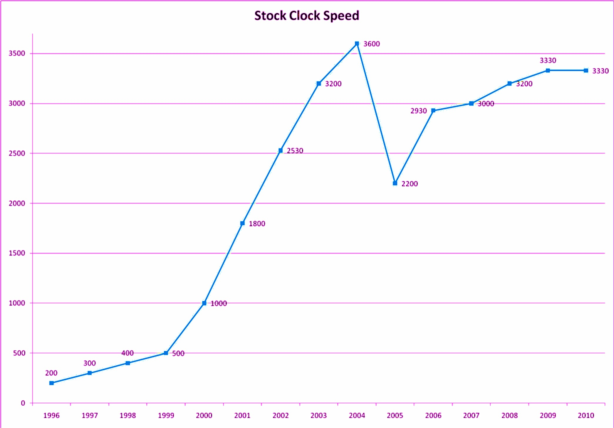
CPU frequency is not growing anymore
3600
3200
3300
2530
2200
1800
1000
500
200
1996 1997 1998 1999 2000 2001 2002 2003 2004 2005 2006 2007 2008 2009 2010

Slide 3
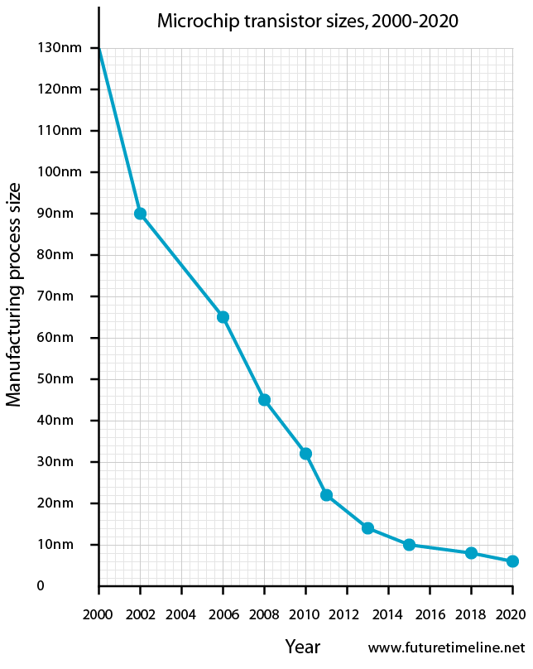
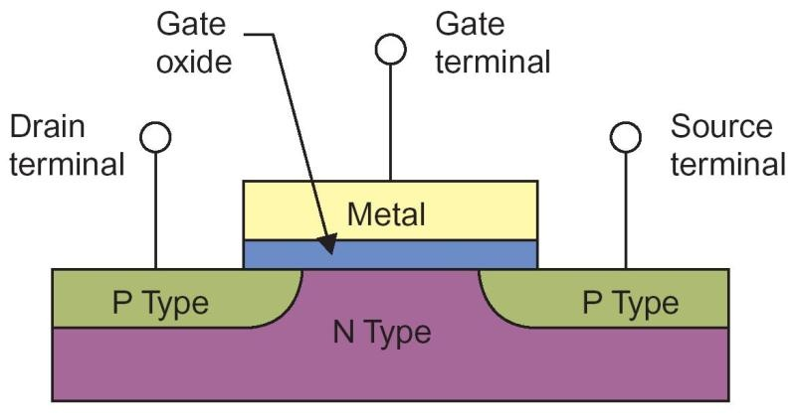
Why CPU frequency doesn’t grow?
Notes:
Gate oxide cannot be smaller because it’s already 1 silicon molecule thick
https://www.quora.com/Why-havent-CPU-clock-speeds-increased-in-the-last-5-years

Slide 4
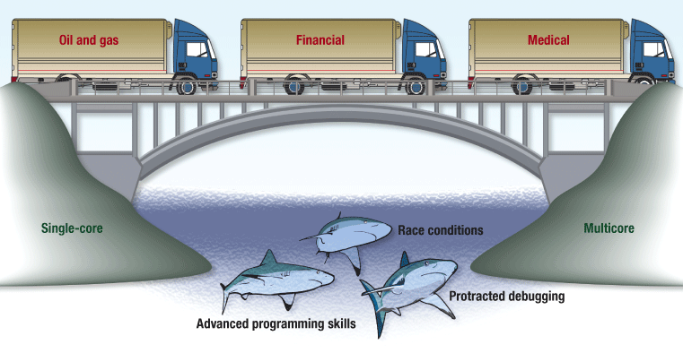
Big move to parallel programming

Slide 5

But how to use threads in Java?

Slide 6
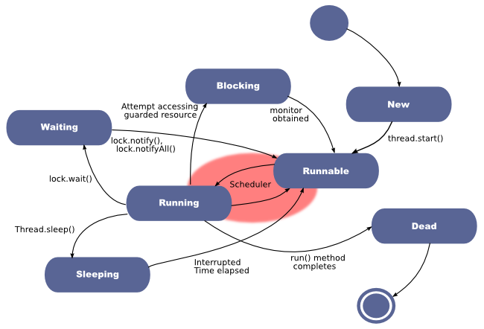
Threads! Really simple to use…

Slide 7

Threads! Really simple to use…
Terrible complexity…
Plus concurrency problems:
data race
race conditions
deadlocks
live locks
starvation
etc.

Slide 8

Multithreading in reality

Slide 9

So… how to improve it?

Slide 10


Parallel and asynchronous programming
parallel
asynchronous
no issues with atomicity or visibility
no context switching

Slide 11
Parallel and asynchronous programming
threads 1&2
use same
shared
resource
thread 1
thread 1
thread 1
thread 2
thread 2
thread 3
thread 3
t3 is blocked (e.g., on DB call)
parallel
async task
main thread
async task
async task
async task
asynchronous

Slide 12
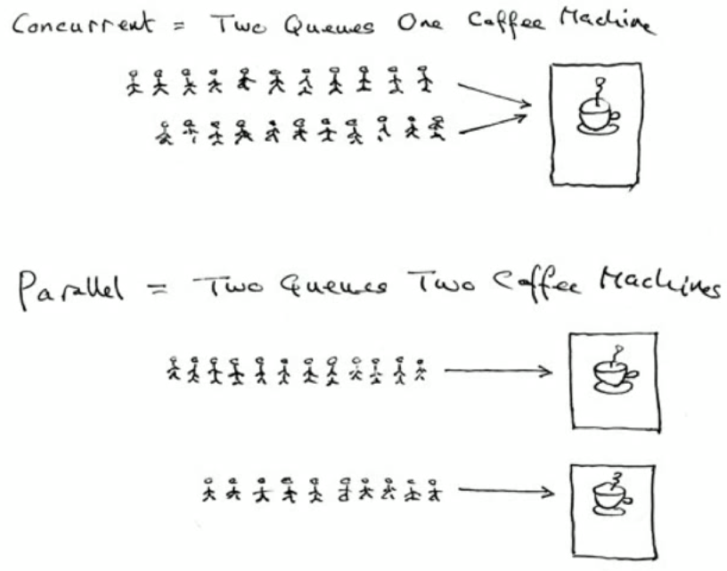
Concurrency and parallelism
Question: how will this scenario work with asynchronicity?

Slide 13
Synchronous I/O: Threads get blocked!
readFile() readDB() …
Such calls are blocking!
waiting
waiting
waiting
waiting
blocked on
reading file
blocked on
reading
from DB
blocked on
heavy
calculations
blocked on
replying to
the client

Slide 14

Synchronous I/O: We get a queue of clients
the queue of clients
waiting
waiting
waiting
waiting
blocked on
reading file
blocked on
reading
from DB
blocked on
heavy
calculations
blocked on
replying to
the client

Slide 15
What is a problem in synchronous code?
readFile() readDB() …
Let’s create more threads…
We’ll have the same situation, just a little bit later…
waiting
waiting
processing
waiting
waiting
waiting
waiting
waiting
waiting
processing
waiting
waiting

Slide 16
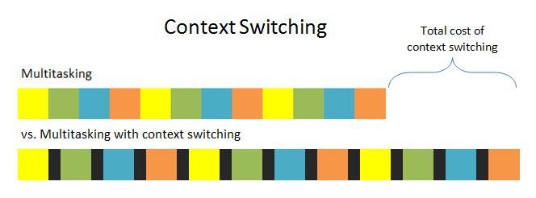
What is a problem in synchronous code?
…and we'll have CS overhead
For sure, we have instruments to deal with these issues:
BlockingQueue
ThreadPool

Slide 17
Solution: Asynchronous I/O
Thread waits on file I/O
Thread does NOT wait on file I/O

Slide 18
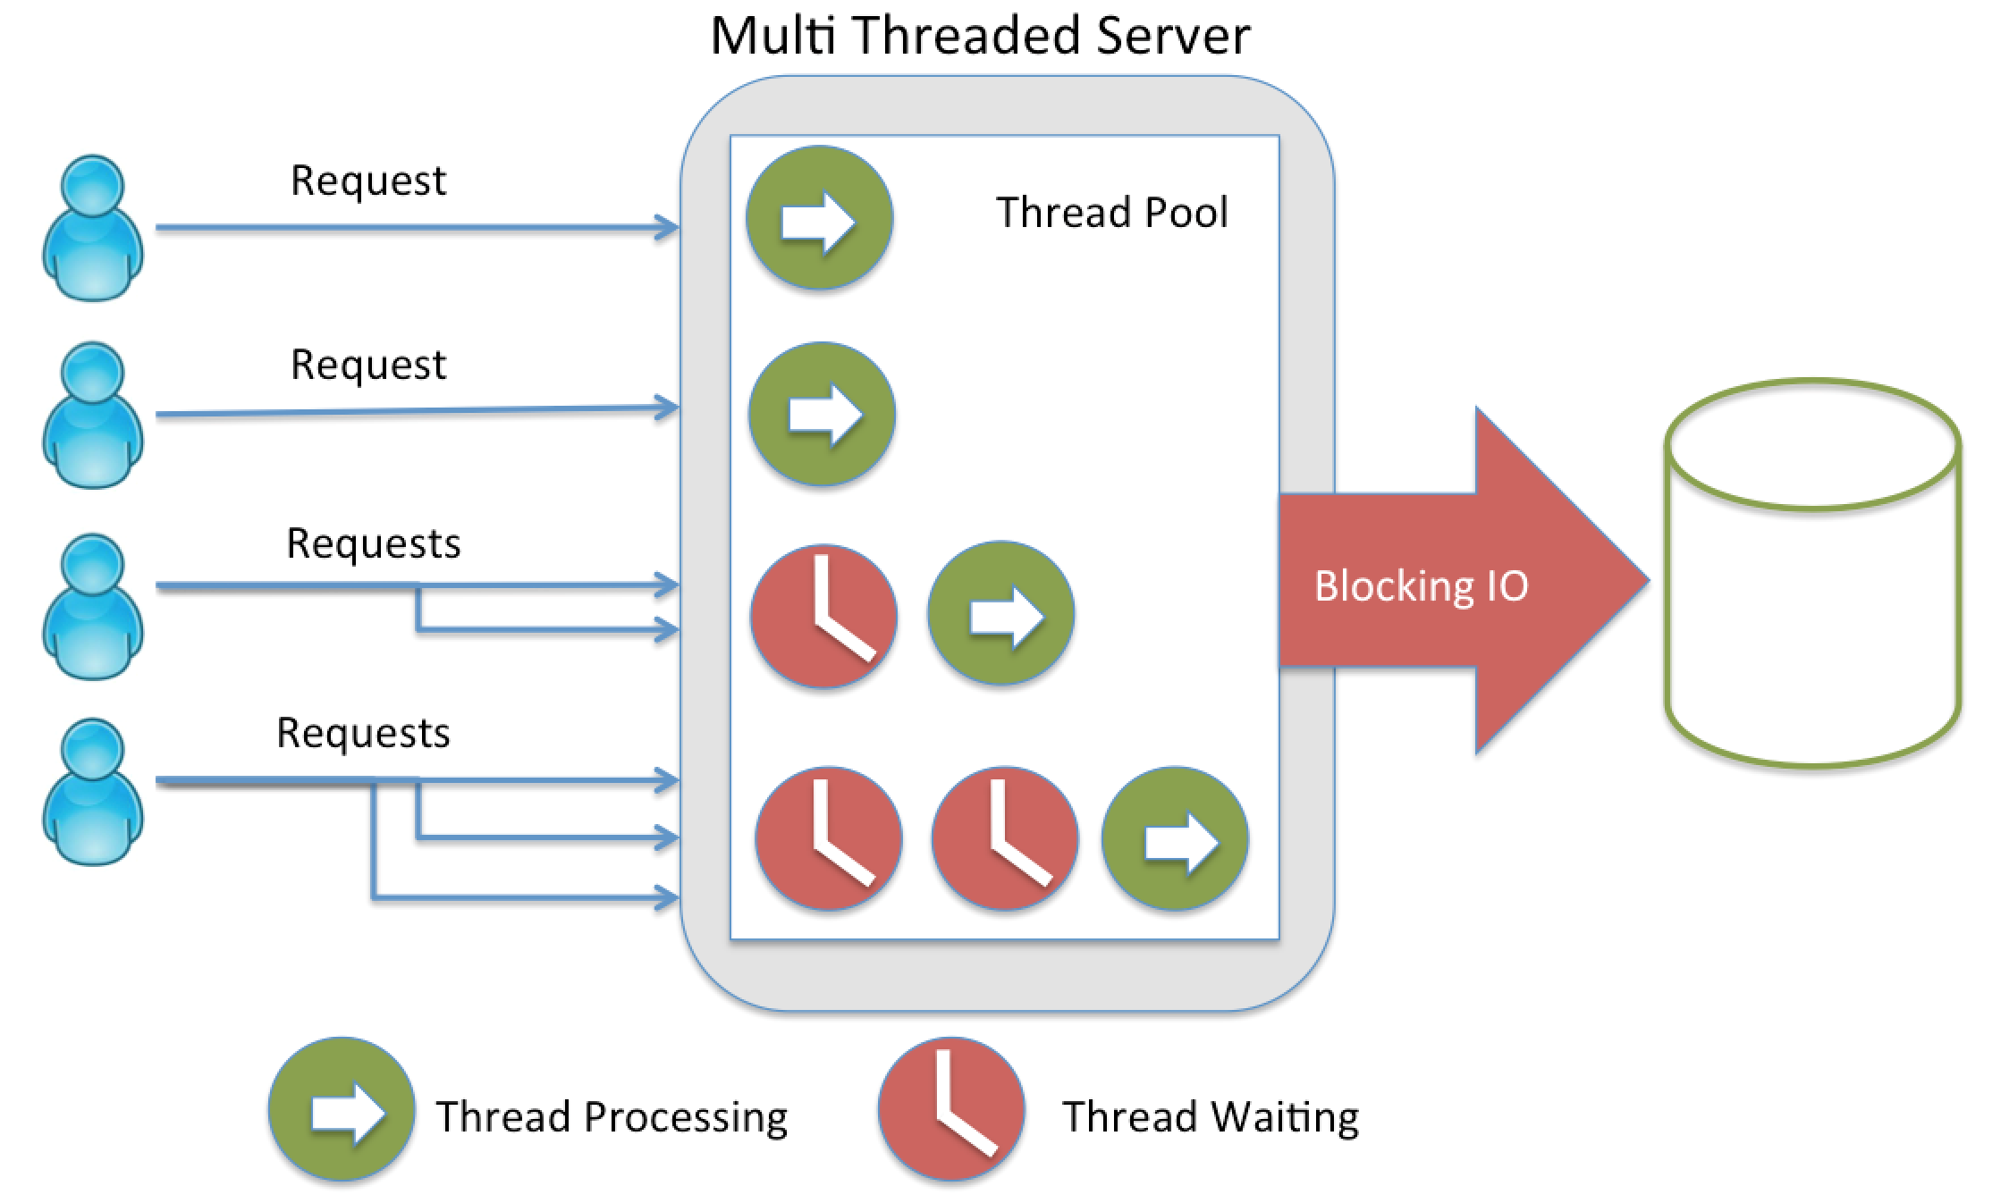
What happens in Java?

Slide 19
History of multithreading:
Good old Java (pre-1.5):
explicit threads creation
synchronized
wait()/notify()
Difficult to write, debug and test

Slide 20
History of multithreading: Java 5
Future interface
V get()
boolean cancel()
boolean isCancelled()
boolean isDone()
Executors
Callable interface
BlockingQueue
Now it's easier to execute in parallel, but how to define data flow?

Slide 21
Data Flow
readData.get()
processData.get()
writeData.get()
We get synchronous code
But we want to run tasks asynchronously…
But how?
read
data
process data
write
data

Slide 22
Data Flow
read data async
process data async
process data async
process data async
combine
write data

Slide 23
Limitation of Future
Cannot be completed manually
No further action on a Future’s result without blocking
Cannot chain multiple Futures
Cannot combine multiple Futures
No exception handling

Slide 24
CompletableFuture to the resque!
CompletableFuture
Java 8
Java 7
Java 5
Java 1
Fork/Join Framework
Executor Framework
Threads

Slide 25

Note: We'll be using JUnit to run our code

Slide 26
Long running method slowInit()
public Integer slowInit() {
System.out.println("started task slowInit()");
try {
Thread.sleep(1000);
} catch (InterruptedException e) {
e.printStackTrace();
}
return 1;
}
defined in: CF00_CompletableFutureBase

Slide 27
Java 1 through 4: Plain old Java multithreading
int result;
public void testFutureOldStyle() throws InterruptedException {
Thread t = new Thread() {
@Override
public void run() {
result = slowInit();
};
};
t.start();
t.join();
System.out.println("futureTest() is done: "+ result);
}
Exercise: CF01_FutureJavaOld
started task slowInit()
futureTest() is done: 1

Slide 28
Java 5 through 7: using Executor to run slowInit()
public void futureTest() throws InterruptedException, ExecutionException {
Callable<Integer> r = this::slowInit;
ExecutorService exec = Executors.newFixedThreadPool(10);
Future<Integer> future = exec.submit(r);
Integer res = future.get();
System.out.println("futureTest() is finished: " + res);
}
Exercise: CF01_FutureJavaOld (cont'd)
started task slowInit()
futureTest() is done: 1

Slide 29
Java 8: using CompletableFuture to run slowInit()
public void promiseTest() throws InterruptedException, ExecutionException {
CompletableFuture<Integer> future =
CompletableFuture.supplyAsync(this::slowInit);
Integer res = future.get();
System.out.println("promiseTest() is finished: " + res);
}
Exercise: CF01_FutureJavaOld (cont'd)
started task 1
promiseTest() is done: 1

Slide 30
Using CompletableFuture to execute several tasks
public void promiseTestNext() throws InterruptedException, ExecutionException {
CompletableFuture<Void> future =
CompletableFuture
.supplyAsync(this::slowInit)
.thenAccept(
(res) -> { System.out.println("finished " + res); }
)
.thenRun(
() -> { System.out.println("look at results"); }
);
future.get();
System.out.println("promiseTestNext() is finished");
}
Exercise: CF01_FutureJavaOld (cont'd)
started task 1
finished 1
look at results
promiseTestNext() is done

Slide 31
Long running method slowIncrement()
public Integer slowIncrement(Integer i) {
try {
Thread.sleep(1000);
} catch (InterruptedException e) {
e.printStackTrace();
}
System.out.println(
"finished incrementing with the result " + (i+1));
return 1+i;
}
defined in: CF00_CompletableFutureBase

Slide 32
Using CompletableFuture to execute several tasks
public void promiseTestInc() throws Exception {
long start = System.nanoTime();
CompletableFuture<?> future =
CompletableFuture.supplyAsync(this::slowInit) // 1
.thenApply(this::slowIncrement) // 2
.thenApply(this::slowIncrement) // 3
.thenAccept( res ->
System.out.println("async result: " + res) );
future.get();
long elapsedTime = System.nanoTime() – start;
System.out.printf("%d sec passed",
TimeUnit.NANOSECONDS.toSeconds(elapsedTime));
}
Exercise: CF02_CompletableFuture…….
Solve Problem
then look up
Solution
started task 1
finished incrementing with the result 2
finished incrementing with the result 3
async result: 3
3 sec passed //<-- indicates a synchro mode
So, what's the diff btw thenApply() & then Accept()?

Slide 33
Starting several pipelines from the main thread
CompletableFuture<Integer> future1 = CompletableFuture.supplyAsync(this::slowInit) .thenApply(this::slowIncrement);
CompletableFuture<Integer> future2 =
CompletableFuture.supplyAsync(this::slowInit);
// here we do the work by ourselves
Integer res0 = slowInit();
// then combine task results Integer res1 = future1.get(); Integer res2 = future2.get(); System.out.println("tasks finished with results ” + res0 +", " + res1 + " and " + res2);
Hint:
You can also explore which thread does what by calling Thread.currentThread()
Exercise: CF03_Several_Pipelines
started task slowInit()
started task slowInit()
started task slowInit()
finished incrementing with the result 2
tasks finished with results 1, 2 and 1
2 sec passed
future1 (2 sec)
main thread (1 sec)
future2 (1 sec)
2 sec
combining results

Slide 34
Composing Futures to create pipeline
Solve Problem
then look up
Solution
public void promiseTestCompose2() throws Exception {
CompletableFuture<Integer> future1 =
CompletableFuture.supplyAsync(this::slowInit) // 1
.thenApply(this::slowIncrement); // 2
CompletableFuture<Integer> thenCompose =
future1.thenCompose(res ->
CompletableFuture.supplyAsync(()->res)
.thenApply(this::slowIncrement) ); // 3
System.out.println(thenCompose.get());
}
note the object!
Pipeline:
future1
started task 1
finished increment with result 2
finished increment with result 3
3
2
future2
Exercise: CF04_Compose
3

Slide 35
Combining Futures
Solve Problem
then look up
Solution
public void testThenCombine() throws Exception {
CompletableFuture<Integer> future1 = CompletableFuture
.supplyAsync(this::slowInit)
.thenApply(this::slowIncrement); // 2
CompletableFuture<Integer> future2 =
CompletableFuture
.supplyAsync(this::slowInit)
.thenApply(this::slowIncrement); // 2
CompletableFuture<?> future3 = future1
.thenCombine(future2, (x,y)->x+y); // 4
System.out.println("result: "+future3.get()); // result: 4
} // 2 sec passed
Exercise: CF05_Combine
Pipeline:
future1
future2
2
2
future3
(x,y)->x+y
4

Slide 36
Asynchronous then sequential
Pipeline:
public void testThenCombineSync() throws Exception {
CompletableFuture<Integer> initial =
CompletableFuture.supplyAsync(this::slowInit);
CompletableFuture<Integer> future1 =
initial.thenApply(this::slowIncrement);
CompletableFuture<Integer> future2 =
initial.thenApply(this::slowIncrement);
CompletableFuture<Integer> future3 =
future1.thenCombine(future2, (x,y)->x*y);
System.out.println("result: "+future3.get());
} // 3 sec passed
initial
1 sec
1
future1
1 sec
1
future 2
1 sec
2
2
future 3
4
Exercise: CF06A_Async_then_Sequent
Methods without async execute task in
the same thread as the previous task

Slide 37
Asynchronous then parallel
Pipeline:
public void testThenCombineSync() throws Exception {
CompletableFuture<Integer> initial =
CompletableFuture.supplyAsync(this::slowInit);
CompletableFuture<Integer> future1 =
initial.thenApplyAsync(this::slowIncrement);
CompletableFuture<Integer> future2 =
initial.thenApplyAsync(this::slowIncrement);
CompletableFuture<Integer> future3 =
future1.thenCombine(future2, (x,y)->x+y);
System.out.println("result: "+future3.get());
} // 2 sec passed
initial
1 sec
1
1
future1
1 sec
future 2
1 sec
2
2
future 3
4
Exercise: CF06B_Async_then_Parallel
Methods with async execute
their task in a separate thread

Slide 38
AnyOf(): Find the winner of the competition
Solve Problem
then look up
Solution
public void testAnyOf() throws Exception {
CompletableFuture<Integer> future1 =
CompletableFuture.supplyAsync(this::slowInit) // 1
.thenApply(this::slowIncrement) // 2
.thenApply(this::slowIncrement); // 3
CompletableFuture<Integer> future2 =
CompletableFuture.supplyAsync(this::slowInit) // 1
.thenApply(this::slowIncrement); // 2
CompletableFuture<?> winner =
CompletableFuture.anyOf(future1, future2);
System.out.println("result: "+winner.get()); // result: 2
} // 2 sec passed
Exercise: CF07_Find_Winner
Pipeline:
future1
3 sec
future 2
2 sec
2
winner
2

Slide 39
applyToEither(): Apply a func to the winner
Solve Problem
then look up
Solution
public void testApplyToEither() throws Exception {
CompletableFuture<Integer> future1 =
CompletableFuture.supplyAsync(this::slowInit)
.thenApply(this::slowIncrement)
.thenApply(this::slowIncrement);
CompletableFuture<Integer> future2 =
CompletableFuture.supplyAsync(this::slowInit)
.thenApply(this::slowIncrement);
CompletableFuture<Integer> winner = future1
.applyToEither(future2, this::slowIncrement);
System.out.println("result: "+winner.get()); // result: 3
} // 3 sec passed
Exercise: CF08_Apply_to_Winner
Pipeline:
future1
3 sec
future 2
2 sec
2
winner
1 sec
3

Slide 40
CompletableFuture Methods Summary
Combining:
Input | Output | Sync | Async
- | + |  | supplyAsync
+ | + | thenApply() | ...Async
+ | - | thenAccept() | ...Async
- | - | thenRun() | runAsync
+ otherFuture: combining
+ | + | thenCombine() | ...Async
+ | - | runAfterBoth() | ...Async
- | - | allOf()
+ otherFuture: the quicker wins
+ | + | applyToEither() | ...Async
+ | - | acceptEither() | ...Async
- | - | anyOf()
+ otherFuture: composing
+ | + | thenCompose() | ...Async
future1
future2
combiner
(x,y)->x+y
Quicker wins:
future1
2 sec
future2
1 sec
winner
Composing:
future1
future2

Slide 41
Handling exceptions with exceptionally()
CompletableFuture<Integer> future =
CompletableFuture.supplyAsync(this::slowInit)
.thenApply(this::slowIncrementException)
.thenApply(this::slowIncrement)
// this function will be executed only in case of an exception
.exceptionally(ex -> {
System.out.println("exception occured!");
return 0;
}).thenApply(this::slowIncrement);
Integer result = future.get();
System.out.println(result);
Exercise: CF09_Exceptionally
if exception was raised:
exception occured!
1
if there was no exception:
4

Slide 42
Handling exceptions with handle()
Exercise: CF10_Handle
CompletableFuture<Integer> future =
CompletableFuture.supplyAsync(this::slowInit)
.thenApply(this::slowIncrementException)
.handle((ok, ex) -> {
if (ex!=null) System.out.println("exception occured");
return ok == null ? 0 : ok; // return 0 if exception was thrown; 0 is the flag that may
// enable further processing by other dependent stages
}).thenApply(this::slowIncrement); Integer result = future.get();
System.out.println(result);
if exception was raised:
exception occured!
1

Slide 43
Using checkpoints in exception handling
Exercise: CF11_Checkpoints
We can ask MyException to keep the previously calculated value, a "checkpoint" of sorts.
CompletableFuture<Integer> future
= CompletableFuture.supplyAsync(this::slowInit) // 1
.thenApply(this::slowIncrement) // 2
.thenApply(this::slowIncrementException) // 3
.exceptionally(ex -> {
System.out.println("Exception 1 occured!");
return ex.getCause() instanceof CF00_MyException
? ((CF00_MyException) ex.getCause()).getCheckpoint()
: 0;})
.thenApply(this::slowIncrement) // 4
.thenApply(this::slowIncrementException) // 5
.exceptionally(ex -> {
System.out.println("Exception 2 occured!");
return ex.getCause() instanceof CF00_MyException
? ((CF00_MyException) ex.getCause()).getCheckpoint()
: 0;})
.thenApply(this::slowIncrement); // 6
Integer result = future.get(); // no exceptions: 6
// a single exception: 5
// both exceptions: 4
System.out.println(result);

Slide 44
Cancellation of CompletableFuture
CompletableFuture<Integer> future =
CompletableFuture.supplyAsync(this::slowInit)
.thenApply(this::slowIncrement);
future.cancel(true); // can predicate on a condition, too
System.out.println( future.isCancelled() ); // true
System.out.println( future.isCompletedExceptionally() ); // true
try {
Integer result = future.get(); // results in CancellationException
System.out.println(result);
} catch (CancellationException ex) {
System.out.println("cancellation exception");
}

Slide 45
Data Flow: Re-cap
read data async
process data async
process data async
process data async
combine
write data

Slide 46
CompletableFuture in a Data Flow scenario:
// API
public CompletableFuture<Data> readData(Source source);
public Data processData1(Data data);
public Data processData2(Data data);
public Data mergeData(Data a, Data b);
public void writeData(Data data, Destination dest);
CompletableFuture<Data> data = readData(source);
CompletableFuture<Data> processData1 =
data.thenApplyAsync(this::processData1);
CompletableFuture<Data> processData2 =
data.thenApplyAsync(this::processData2);
processData1
.thenCombine(processData2,
(a, b)->mergeData(a,b))
.thenAccept(
data->writeData(data, dest));
read data async
process data 1
process data 2
combine
write data

Slide 47
Using events for asynchronous calls
Event-based
Data Flow
reader
read data async
processor
processor
process data async
process data async
combine
combiner
writer
write data
JMS (Java Message Service), AKKA
CompletableFuture

Slide 48
Java Technologies Supporting Asynchronous Paradigm
Servlets
JAX-RS – asynchronous on server and client
EJB
WebSocket
NIO (but has no CompletableFuture support)
SpringMVC, SpringREST
…
but not JDBC!..

